Slide 1
Chapter 1:
The Database Environment
Modern Database Management
6th Edition
Jeffrey A. Hoffer, Mary B. Prescott, Fred R. McFadden

Slide 2
Definitions
Data: Meaningful facts, text, graphics, images, sound, video segments
Database: An organized collection of logically related data
Information: Data processed to be useful in decision making
Metadata: Data that describes data

Slide 3
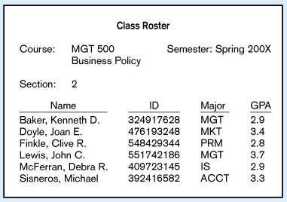
Figure 1-1a Data in Context
Large volume of facts, difficult to interpret or make decisions based on

Slide 4
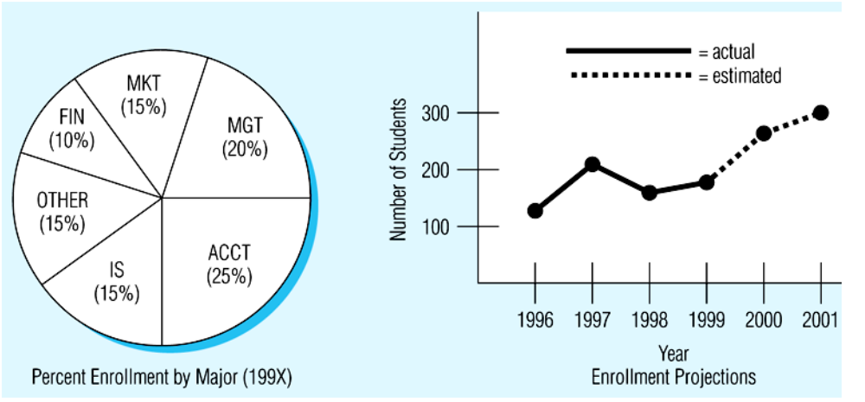
Figure 1-1b Summarized data
Useful information that managers can use for decision making and interpretation

Slide 5
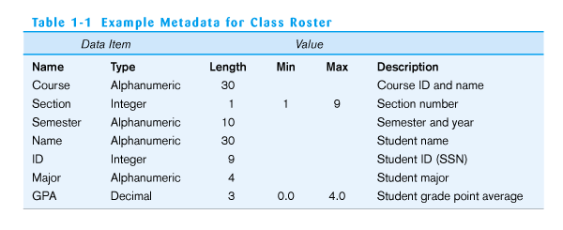
Table 1-1 Metadata
Descriptions of the properties or characteristics of the data, including data types, field sizes, allowable values, and documentation

Slide 6
Disadvantages of File Processing
Program-Data Dependence
  All programs maintain metadata for each file they use
Data Redundancy (Duplication of data)
  Different systems/programs have separate copies of the same data
Limited Data Sharing
  No centralized control of data
Lengthy Development Times
  Programmers must design their own file formats
Excessive Program Maintenance
  80% of of information systems budget

Slide 7
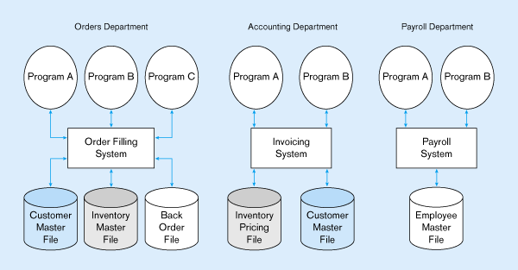
Figure 1-2 Three file processing systems at Pine Valley Furniture
Duplicate Data

Slide 8
Problems with Data Dependency
Each application programmer must maintain their own data
Each application program needs to include code for the metadata of each file
Each application program must have its own processing routines for reading, inserting, updating and deleting data
Lack of coordination and central control
Non-standard file formats

Slide 9
Problems with Data Redundancy
Waste of space to have duplicate data
Causes more maintenance headaches
The biggest Problem:
  When data changes in one file, could cause inconsistencies
  Compromises data integrity

Slide 10
SOLUTION:
The DATABASE Approach
Central repository of shared data
Data is managed by a controlling agent
Stored in a standardized, convenient form
Requires a Database Management System (DBMS)

Slide 11
Database Management System
A DBMS is a data storage and retrieval system which permits data to be stored non-redundantly while making it appear to the user as if the data is well-integrated.

Slide 12
Database Management System
Application
#1
DBMS
Application
#2
Database
containing
centralized
shared data
Application
#3
DBMS manages data resources like an operating system manages hardware resources

Slide 13
Advantages of Database Approach
Program-Data Independence
  Metadata stored in DBMS, so applications don’t need to worry about data formats
  Data queries/updates managed by DBMS so programs don’t need to process data access routines
  Results in: increased application development and maintenance productivity
Minimal Data Redundancy
  Leads to increased data integrity/consistency

Slide 14
Advantages of Database Approach
Improved Data Sharing
  Different users get different views of the data
Enforcement of Standards
  All data access is done in the same way
Improved Data Quality
  Constraints, data validation rules
Better Data Accessibility/ Responsiveness
  Use of standard data query language (SQL)
Security, Backup/Recovery, Concurrency
  Disaster recovery is easier

Slide 15
Costs and Risks of the
Database Approach
Up-front costs:
  Installation Management Cost and Complexity
  Conversion Costs
Ongoing Costs
  Requires New, Specialized Personnel
  Need for Explicit Backup and Recovery
Organizational Conflict
  Old habits die hard

Slide 16
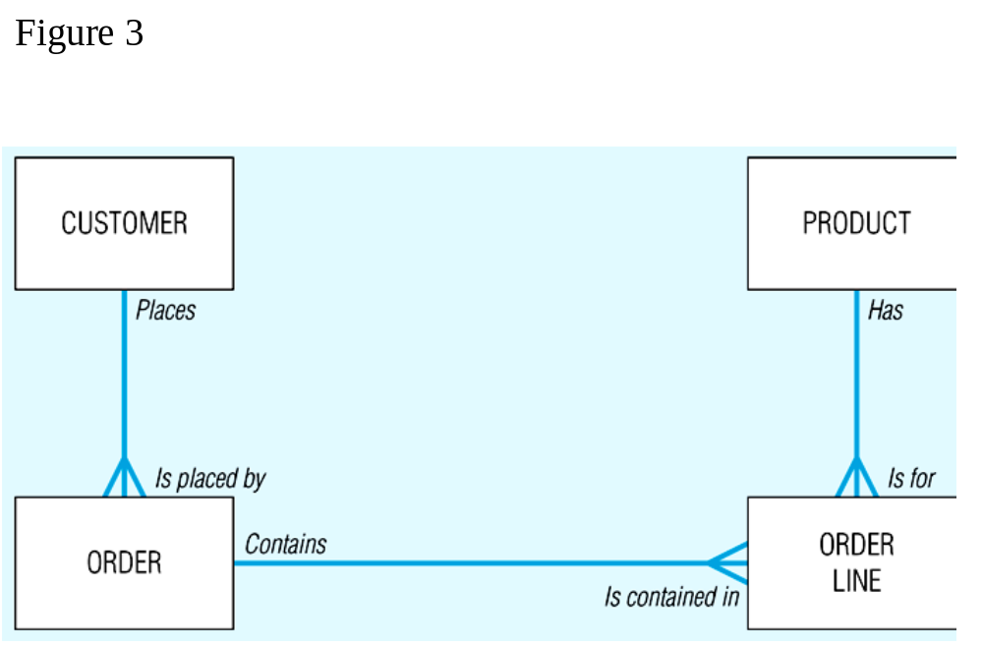
Figure 1-3 Segment from enterprise data model

Slide 17
Figure 1-3 Segment from enterprise data model
One customer may place many orders, but each order is placed by a single customer
→ One-to-many relationship

Slide 18
Figure 1-3 Segment from enterprise data model
One order has many order lines; each order line is associated with a single order
→ One-to-many relationship

Slide 19
Figure 1-3 Segment from enterprise data model
One product can be in many order lines, each order line refers to a single product
→ One-to-many relationship

Slide 20
Figure 1-3 Segment from enterprise data model
Therefore, one order involves many products and one product is involved in many orders
→ Many-to-many relationship

Slide 21
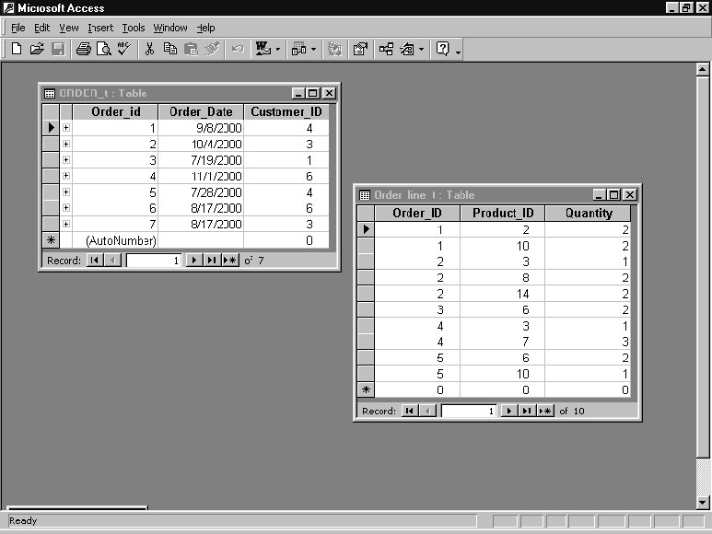
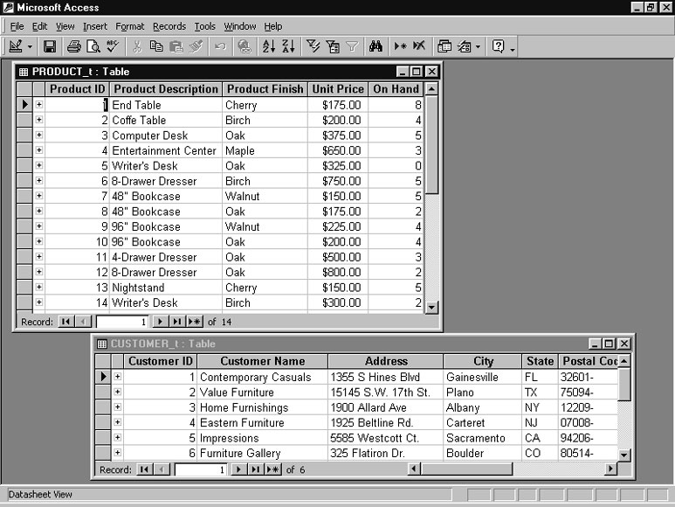
Figure 1-4 Order, Order_Line, Customer, and Product tables
Relationships established in special columns that provide links between tables

Slide 22
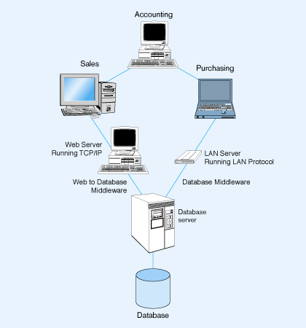
Figure 1-5 Client/server system for Pine Valley Furniture Company

Slide 23
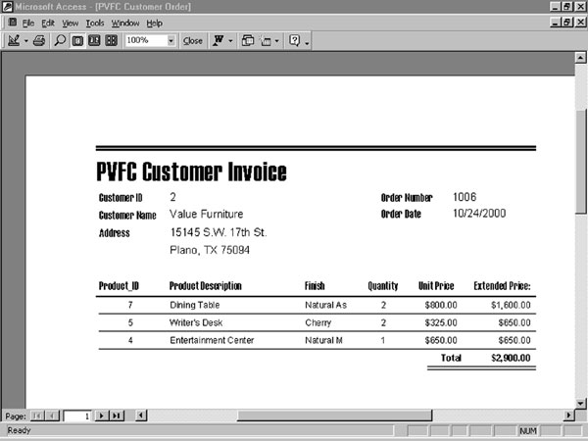
Figure 1-6 Customer invoice (Pine Valley Furniture Company)
Application program functions:
inserting new data, updating existing data,
deleting existing data, reading data for display

Slide 24
The Range of
Database Applications
Personal Database – standalone desktop database
Workgroup Database – local area network (<25 users)
Department Database – local area network (25-100 users)
Enterprise Database – wide-area network (hundreds or thousands of users)

Slide 25
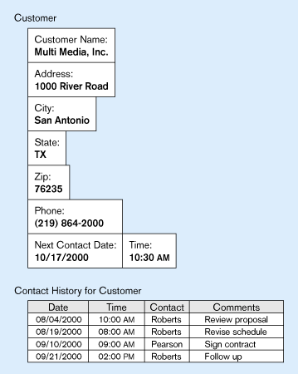
Figure 1-7 Typical data from a personal computer database

Slide 26
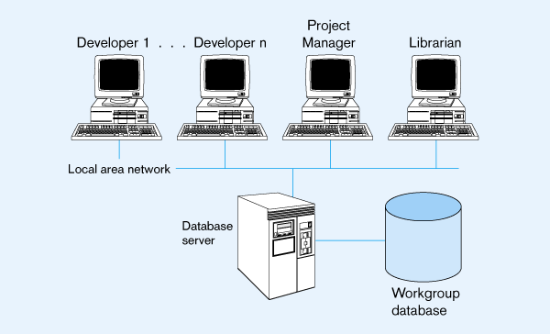
Figure 1-8 Workgroup database with local area network

Slide 27
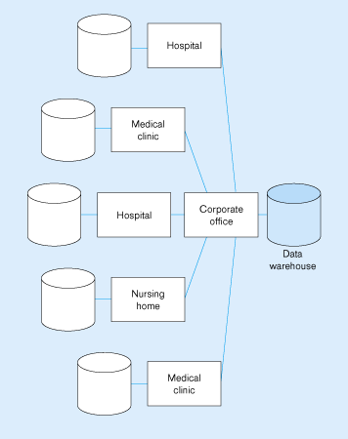
Figure 1-9 An enterprise data warehouse

Slide 28
Components of the
Database Environment
CASE Tools – computer-aided software engineering
Repository – centralized storehouse of metadata
Database Management System (DBMS) – software for managing the database
Database – storehouse of the data
Application Programs – software using the data
User Interface – text and graphical displays to users
Data Administrators – personnel responsible for maintaining the database
System Developers – personnel responsible for designing databases and software
End Users – people who use the applications and databases

Slide 29
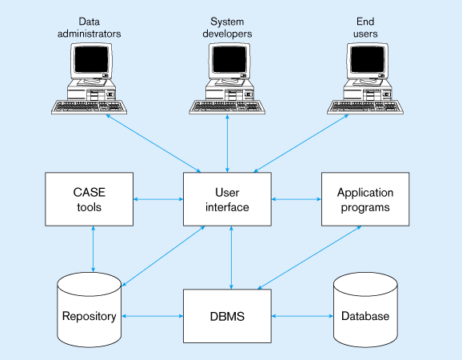
Figure 1-10 Components of the database environment

Slide 30
Evolution of DB Systems
Flat files - 1960s - 1980s
Hierarchical – 1970s - 1990s
Network – 1970s - 1990s
Relational – 1980s - present
Object-oriented – 1990s - present
Object-relational – 1990s - present
Data warehousing – 1980s - present
Web-enabled – 1990s - present

